Slide 1
WELCOME TO OUR PRESENTATION

Slide 2

BANGLADESH UNIVERSITY OF PROFESSIONALS
“C PROGRAM TO FIND THE CALENDAR OF THE GIVEN YEAR”
PRESENTED TO:
DR. RASHED MAJUMDER
ASSISTANT PROFESSOR, IIT, JU.
COURSE NAME: STRUCTURED PROGRAMMING Lab
COURSE CODE: 1102
SUBMISSION DATE: 30.01.2022

Slide 3
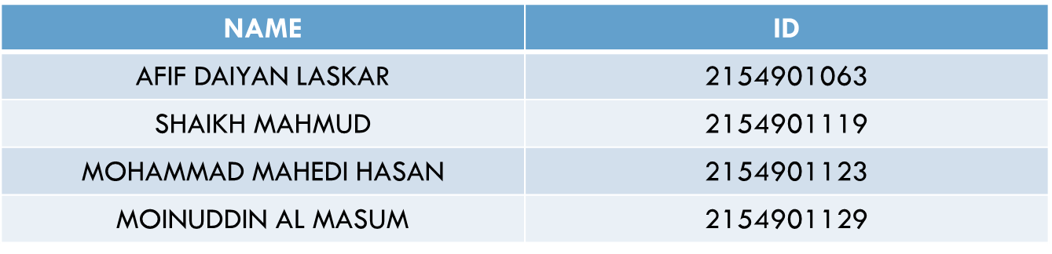
C PROGRAM TO FIND THE CALANDER OF THE GIVEN YEAR
C PROGRAM TO FIND THE CALENDAR OF THE GIVEN YEAR
PRESENTED BY
BANGLADESH UNIVERSITY OF PROFESSIONALS

Slide 4
WORK DISTRIBUTION
Name | Work
AFIF DAIYAN LASKAR | Coding
SHAIKH MAHMUD | Slides
MOHAMMAD MAHEDI HASAN | Coding
MOINUDDIN AL MASUM | Presentation

Slide 5
INTRODUCTION
Our project shows you the calendar of a year. It helps us keeping track of our day to day lives.

Slide 6
IMPLEMENTATION REQUIREMENTS
This application size is 31 kb and the size of code is 3 kb.
Ram : Minimum 256MB.
Mouse , Keyboard.

Slide 7
Software requirements
Code blocks
Windows 10

Slide 8
Algorithms
No algorithm used.

Slide 9
Demonstration
1) #include<stdio.h>
2) #define TRUE 1
3) #define FALSE 0
4) int days_in_month[]={0,31,28,31,30,31,30,31,31,30,31,30,31};
5) char *months[]=
6) {
7) " ",
8) "\n\n\n----------------- January ----------------",
9) "\n\n\n----------------- February ----------------",
10) "\n\n\n----------------- March -----------------",
11) "\n\n\n----------------- April -----------------",
12) "\n\n\n----------------- May -----------------",
13) "\n\n\n----------------- June -----------------",
14) "\n\n\n----------------- July -----------------",
15) "\n\n\n----------------- August -----------------",
16) "\n\n\n----------------- September -----------------",
17) "\n\n\n----------------- October -----------------",
18) "\n\n\n----------------- November -----------------",
19) "\n\n\n----------------- December -----------------",
20) };

Slide 10
21) int inputyear(void)
22) {
23) int year;
24) printf("Please enter a year : ");
25) scanf("%d", &year);
26) return year;
27) }
28) int determinedaycode(int year)
29) {
30) int daycode;
31) int d1, d2, d3;
32) d1 = (year - 1.)/ 4.0;
33) d2 = (year - 1.)/ 100.;
34) d3 = (year - 1.)/ 400.;
35) daycode = (year + d1 - d2 + d3) %7;
36) return daycode;
37) }

Slide 11
38) int determineleapyear(int year)
39) {
40) if(year% 4 == FALSE && year%100 != FALSE || year%400 == FALSE)
41) {
42) days_in_month[2] = 29;
43) return TRUE;
44) }
45) else
46) {
47) days_in_month[2] = 28;
48) return FALSE;
49) }
50) }
51) void calendar(int year, int daycode)
52) {
53) int month, day;
54) for ( month = 1; month <= 12; month++ )
55) {
56) printf("%s", months[month]);
57) printf("\n\nSun Mon Tue Wed Thu Fri Sat\n" );
58) for ( day = 1; day <= 1 + daycode * 5; day++ )
59) {
60) printf(" ");
61) }

Slide 12
62) for ( day = 1; day <= days_in_month[month]; day++ )
63) {
64) printf("%2d", day );
65) if ( ( day + daycode ) % 7 > 0 )
66) printf(" " );
67) else
68) printf("\n " );
69) }
70) daycode = ( daycode + days_in_month[month] ) % 7;
71) }
72) }
73) int main(void)
74) {
75) int year, daycode, leapyear;
76) year = inputyear();
77) daycode = determinedaycode(year);
78) determineleapyear(year);
79) calendar(year, daycode);
80) printf("\n");
81) }

Slide 13
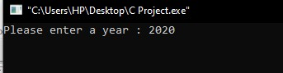
Input

Slide 14
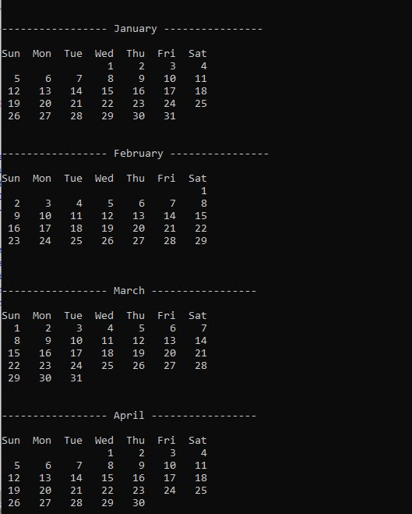
Output

Slide 15
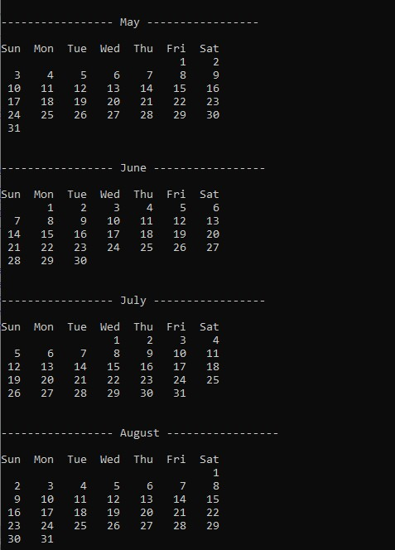

Slide 16
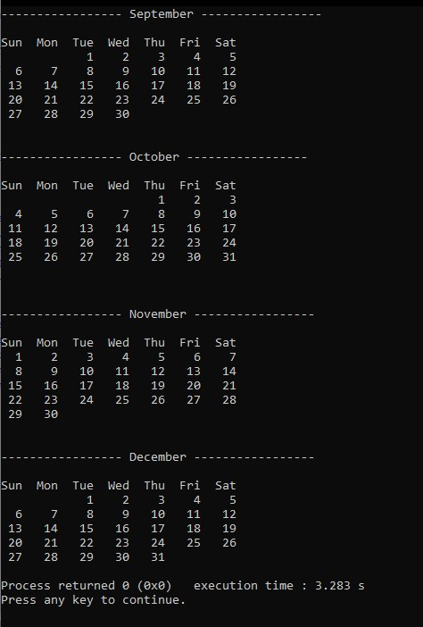

Slide 17
Conclusion
We are using calendar in our everyday life. Calendars are useful for keeping track of our upcoming meetings, deadlines and milestones. They can can help us visualize our schedule and remind us of important events such as, holidays and vacation time.

Slide 18


Slide 19


